Slide 1
SharePoint Server 2010 Developer Roadmap
Notes:
This lecture has several goals
To provide a high-level overview of SharePoint Server 2010
To list the major components and services of SharePoint Server 2010
To get you started creating and developing SharePoint 2010 sites

Slide 2
Outline
What’s New in SharePoint 2010
SharePoint 2010 Development Primer
New Developer Tools for SharePoint 2010
SharePoint 2010 Integration with PowerShell

Slide 3
SharePoint 2007
Windows SharePoint Services (WSS v3)
Site and Workspace Provisioning Engine
Out-of-the-box Collaboration Services
Microsoft Office SharePoint Server (MOSS)
User Profiles, Search, Workflows, WCM
BDC, Excel Services, Forms Services, ECM
Browser Clients
Microsoft Office SharePoint Server 2007 (MOSS)
MS Word Clients
Windows SharePoint Services 3.0 (WSS v3)
MS Outlook Clients
.NET Framework 3.0
Internet Information Services 6.0 or 7.0
Windows Server 2003 or 2008 (32-bit or x64)
Notes:
Many student will be familiar with WSS 3.0 and MOSS. Here are some questions that each student should answer.
Are you familiar with MOSS 2007 and WSS 3.0
as a user?
as a site administrator?
as a farm administrator?
as a developer?
What types of components have you developed for SharePoint?
Features and Solution packages
Web Parts and Event Handlers
ListDefs and SiteDefs
What Tools and utilities have you used?
Visual Studio Extensions for WSS 3.0
CodePlex utilities

Slide 4
SharePoint Server 2010 and related technologies
An evolved version of MOSS and WSS v3
Microsoft SharePoint Server 2010
Microsoft SharePoint Foundation 2010
Development can now be done on client OS
Significant enhancement for many development teams
Browser Clients
Microsoft SharePoint Server 2010
MS Word Clients
Microsoft SharePoint Foundation 2010
MS Outlook Clients
.NET Framework and ASP.NET 3.5 SP1
Internet Information Services 7.0
Windows Server 2008 (x64 only) for Production Environments
Windows 7 or Vista (x64 only) for Development Environments only
Notes:
SharePoint Server 2010 is the next version of the SharePoint technology stack. There will be three different SKUs for SharePoint Server 2010
SharePoint 2010 Server Enterprise
SharePoint 2010 Server Standard
Microsoft SharePoint Foundation
SharePoint 2010 Server only runs on 64-bit operating systems. This is different from MOSS 2007 and WSS 3.0 which ran on either a 32-bit OS and a 64-bit OS.
SharePoint 2010 Server is the first version of the product that supports installation on a client OS for development. The supported clients Oss included 64-bit version of Windows 7 and Windows Vista.

Slide 5



Microsoft SharePoint 2010 The business collaboration platform for the Enterprise and the Web
Sites
Connect and Empower People
Cut Costs with a Unified Infrastructure
Rapidly Respond to Business Needs
Composites
Communities
Insights
Content
Search
Notes:
The value proposition of SharePoint 2010 can be split across 6 functional areas as seen in what is commonly referred to as the "SharePoint Pie". Here is a quicker decoder ring to understand what each piece of the pie is all about.
Sites: Collaboration (e.g. Team sites)
Communities: Social networking (Blogs, Wikis, User profiles)
Search: Content discovery and connecting people
Content: WCM, ECM, DM and RM
Composites: Building no-code applications with external data (BCS)
Insights: Business Intelligence and Reporting

Slide 6
What's New in SharePoint 2010
Improvements to UI and accessibility features
Better Tools for Developers and Designers
End-to-end Integration with PowerShell
Improvements to lists and events
New WSS integration with LINQ
New client-side object model and runtime
Enhanced support for developing workflow applications
New Extensible architecture for service applications
Evolving story for integrating SharePoint with external data
New Connector framework enhances Search architecture
User Solutions and Partially Trusted Code
The shift to claims-based security
Notes:
You can see from this list there are quite a few things for developers to get excited about when moving to SharePoint 2010. There is no need to drill into each of these bullets at this stage of the course but rather just to give students familiar with SharePoint 2007 a quick idea of the new surface area that they have to work with.

Slide 7
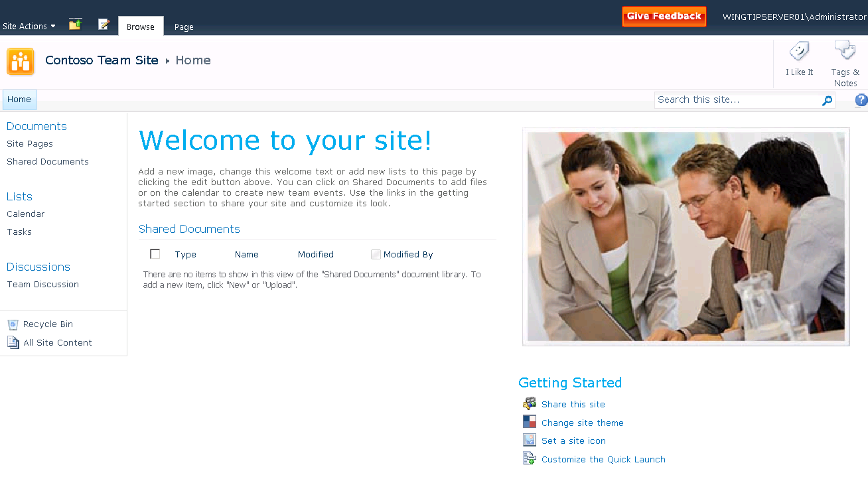
SharePoint 2010 Team Site
Notes:
The SharePoint 2007 Team site looks quite a bit different from SharePoint 2007
Master page has changed (Site Action menu now on left)
Home Page is a wiki page (SitePages/Home.aspx)
New lists and galleries created behind the scenes

Slide 8
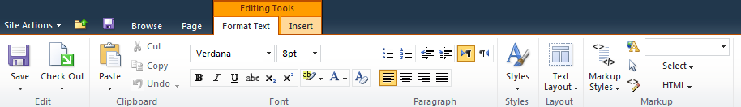
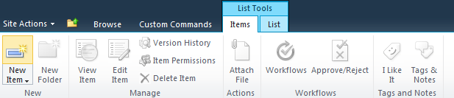

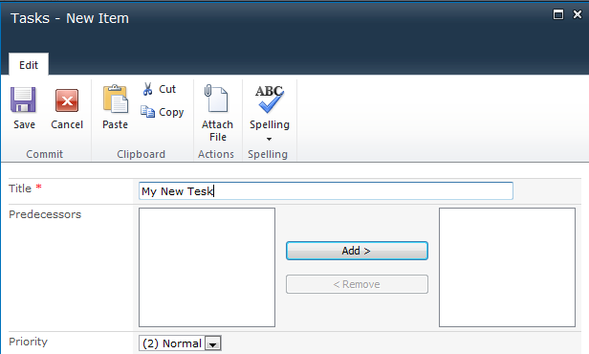

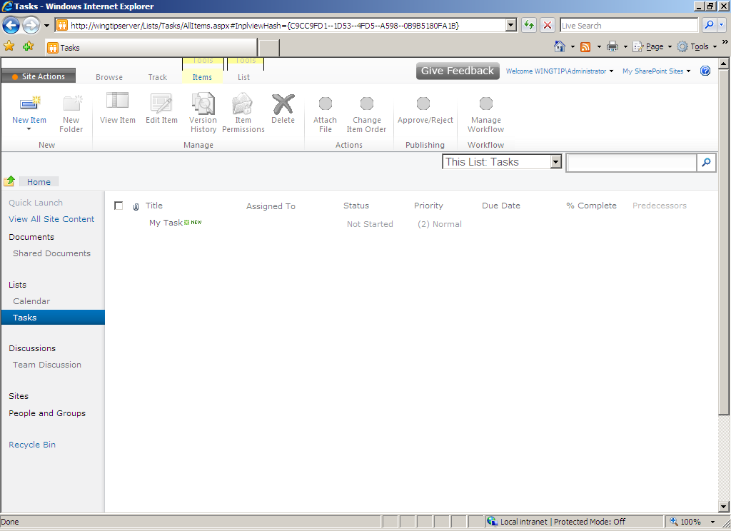
Major Shifts in SharePoint UI
Server ribbon
In-place editing
Popup dialog
AJAX refresh
Notes:
There has been a major overhaul to the most basic aspects of the SharePoint UI. Many of these changes have been designed to get rid of all the HTTP postbacks that are required when making updates in the browser. SharePoint 2010 has a new core engine for processing pages based on ASP.NET AJAX and designed to delivery a more of a Web 2.0 user experience.
SharePoint 2010 adds a new server-side ribbon to create a consistency with the client-side ribbon added to Office applications with the release of the Office 2007 system. The ribbon now provides a JavaScript-enabled paradigm where the user can move between modes (e.g. edit mode versus diisplay mode) without sending postbacks to the Web server. In-place editing is the most obvious change that users will notice when moving from SharePoint 2007.

Slide 9
SharePoint 2010 UI
demo
Notes:
The demo by the instructor will include these steps
Create a new Team using SharePoint Central Admin
Navigate to the Team Site and demonstrate new SharePoint 2010 UI
Demonstrate ribbon
Demonstrate in-place editing

Slide 10
Outline
What’s New in SharePoint 2010
SharePoint 2010 Development Primer
New Developer Tools for SharePoint 2010
SharePoint 2010 Integration with PowerShell

Slide 11
SharePoint Terminology Review
- Farm (SPFarm)
- Web Application (SPWebApplication)
- Site Collection (SPSite)
- Site (SPWeb)
- List (SPList)
- Item (SPListItem)
- Document Library (SPDocumentLibrary)
- File (SPFile)
- Folder (SPFolder)
Notes:
This slide is a transition slide to move into a more developer-centric topic. Ask students if they have programmed in the past using these classes which of common types in the SharePoint object model.

Slide 12
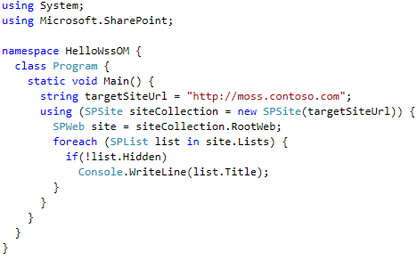
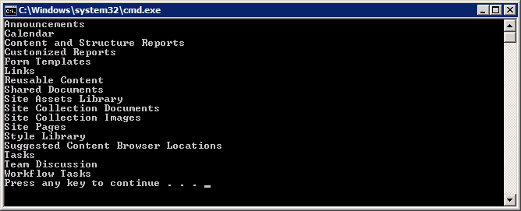
Remember This Code from WSS v3?
Notes:
Things to note about the "Hello world" application - SharePoint style
This code requires a reference to Microsoft.SharePoint.dll.
Call out entering the SharePoint object model using a new SPSite object
Emphasize the need for the using construct to ensure Dispose is called
Many collections in SharePoint object model support For Each enumeration.

Slide 13
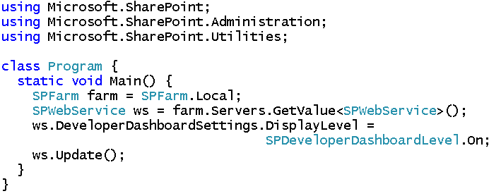
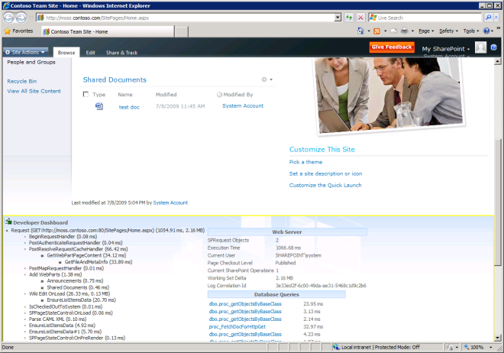
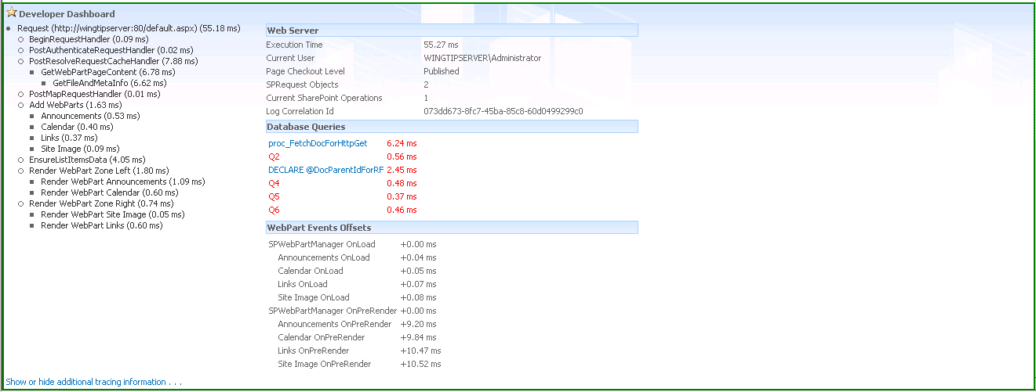
SharePoint 2010 Developer Dashboard
Notes:
The developer dashboard has been introduced with SharePoint Server 2010. It shows diagnostics and performance-related statistics.
How long did the request take to run?
What event handlers were fired?
In what sequence did these event handlers fire?
Currently with Beta1 there is no built-in UI component that allows a user to enable and disable the developer dashboard. However, you can create a simple Console application that does the trick.

Slide 14
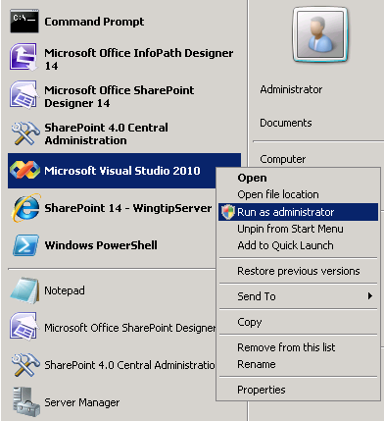
Debugging SharePoint 2010 Code
Make sure that your start VS 2010 as Admin
Required for attaching VS 2010 debugger to IIS Worker Process (W3WP.EXE)
Notes:
Quite often (but not always) you must launch Visual Studio 2010 as Administrator to get debugging working correctly. Much of this has to due with the fact that the identity behind the Windows process for Visual Studio 2010 need sufficient rights to be to attach to and debug the IIS Worker Process (W3WP.EXE)

Slide 15
SharePoint 2010 OM
demo
Notes:
Create a simple Console application
Make a point to mention it has to be built for x64 or Any Platform.
Connect to site using SPSite
Make sure to create new SPSite object inside using construct
Get hold of SPWeb object for top-level site
Enumerate through all lists and print each list title to Console window

Slide 16
Outline
What’s New in SharePoint 2010
SharePoint 2010 Development Primer
New Developer Tools for SharePoint 2010
SharePoint 2010 Integration with PowerShell

Slide 17
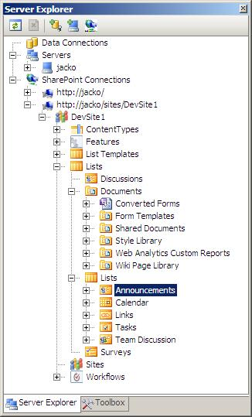
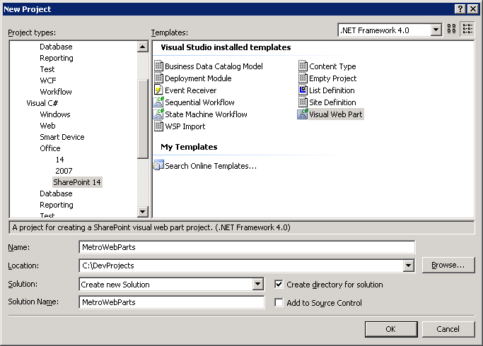
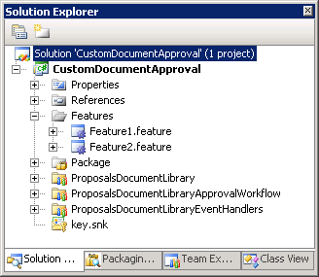
VS 2010 SharePoint Tools
SharePoint 2010 development brings new tools
Created by group within Visual Studio 2010 team
Major step forward from SharePoint 2007 development
New tools target SharePoint 2010 only
These new tools are introduced in lecture 2
SharePoint Explorer
New Project and Item Templates
New Project Structure
Notes:
Next lecture this course will take a deep dive into development using the Visual Studio 2010 SharePoint tools. The main thing to mention is that the Microsoft-provided developer experience is much better with these new tools than anything that have released in the past.

Slide 18
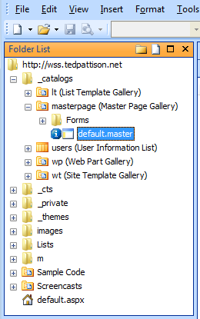
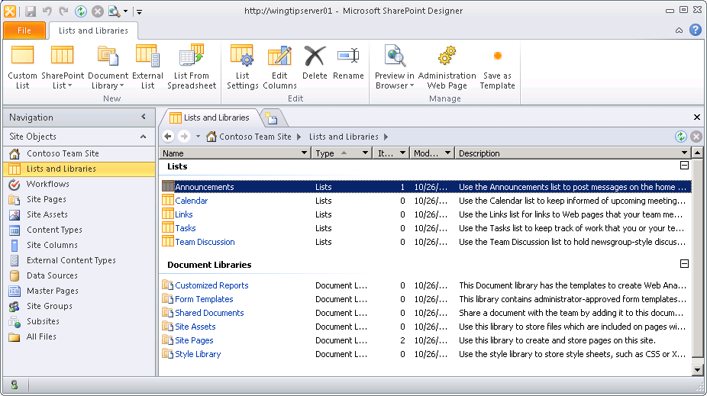
SharePoint Designer Improvements
SPD shell’s focus on SharePoint objects
SPD objects have relationships
Intuitive navigation between SPD objects
SPD work migrates to Visual Studio 2010
SPD customization work exported to .wsp files
.wsp files imported into Visual Studio
New UI focused on SP Objects
SPD 2007 UI
SPD 2010 UI
Notes:
SharePoint Designer has gone through many significant changes
SharePoint objects such as lists and workflow associations are seen as first class objects in the new UI
Each SharePoint object has a summary page
The new workflow designer is much more powerful
SPD can create reusable workflows – this was a big problem in SPD 2007
Prototypes created in SPD can be migrated into Visual Studio 2010

Slide 19
SharePoint Designer 2010
demo
Notes:
This should not be a long demo but a 4-5 minute test drive to quickly show the new UI of the SharePoint Designer
Launch SharePoint Designer
Open site create earlier this lab
Show summary pages for existing lists
Create a new list and show how quick and easy it is to create a custom set of columns

Slide 20
Outline
What’s New in SharePoint 2010
SharePoint 2010 Development Primer
New Developer Tools for SharePoint 2010
SharePoint 2010 Integration with PowerShell

Slide 21

PowerShell Support
Previous version of WSS relies on STSADM.EXE
Used for command line administration and scripting
SharePoint 2010 adds support for PowerShell
PowerShell support effectively replaces STSADM.EXE
SharePoint admins/devs must learn PowerShell basics
You can write powerful scripts against WSS OM
You can develop custom PowerShell snap-ins
STSADM.EXE
We’ll miss you old friend
Notes:
The SharePoint team has now gotten in line with many other server product teams at Microsoft and made SharePoint Server 2010 completely administrate-able through PowerShell scripts
The bottom line is that all administrators and developers working with SharePoint Server 2010 should know or get to know PowerShell scripting. The remainder of this lecture is designed to give an introductory primer for students with either limited or no previous experience with PowerShell.

Slide 22
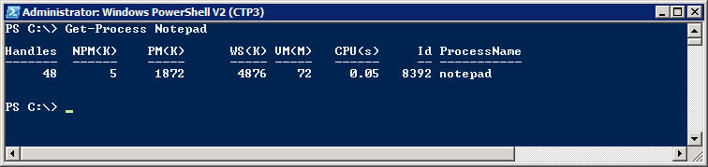
PowerShell Primer for Beginners
What is PowerShell?
A modern replacement for the CMD (command) shell
A powerful scripting environment for administration
Note – VM for this course uses PowerShell V2 (CTP3)
PowerShell fundamentals
Cmdlets (e.g. Get-Process and Stop-Process)
Pipelining and formatting features
Provider-based model for accessing resources
Notes:
Over the last few years, PowerShell scripting has begun to replace older DOS-style batch files and VBScript files as the preferred way to manage and automate administrative tasks
Cmdlets are callable functions
Pipelining allow one Cmdlet to return an object as input to another
PowerShell includes formatting features to display output using lists or tables
PowerShell is based on a provider-based model based on Snap-ins
SharePoint support added through Microsoft.SharePoint.Powershell..
.

Slide 23
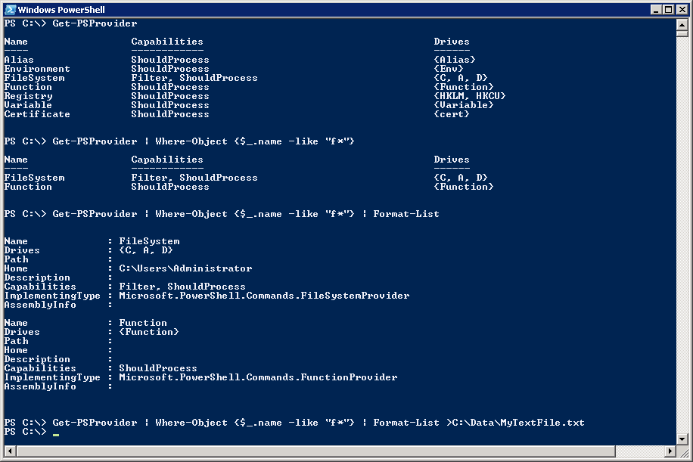
Getting Started with PowerShell
(1) Execute a Cmdlet
(2) Filter results using where clause
(3) Add formatting instructions
(4) Redirect output to new text file
Notes:
The first example shows calling a Cmdlet that takes no parameters
The second example adds filtering by adding a Where command
Where-Object {$_.name –eq "F*"}
The syntaxt $_ refers to the object in question
$_.name refers to the object's name property
-eq is the operator for equals
The third example adds in formmating instructions
The last example redirects output so it is stored in a new text files.

Slide 24
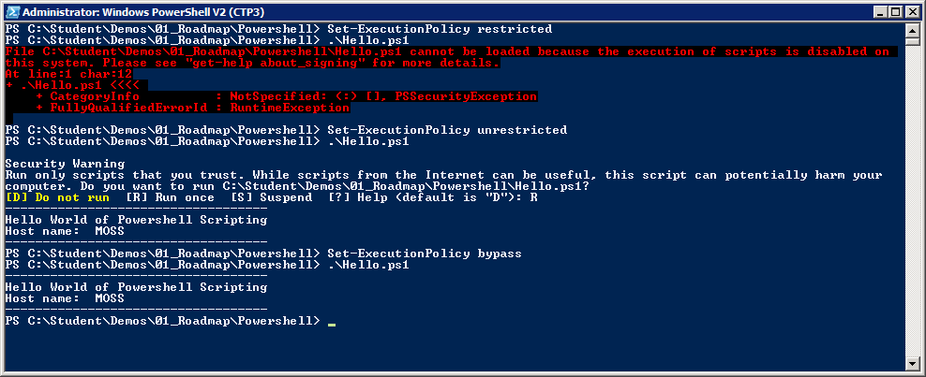
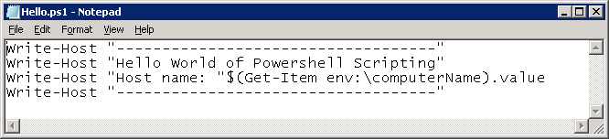
Scripts and Execution Policy
You can author PowerShell scripts
Scripts have .ps1 extension
Local execution policy must be configured
Scripts will not execute under default execution policy of restricted
Scripts can execute under execution policy of unrestricted. Scripts that are not signed result in prompting user for permission to execute.
Scripts can execute under execution policy of bypass. This mode suppresses prompting user for permission to execute.
Notes:
By default, Powershell does not allow script to run
Administrator must change execution policy to enable script execution
Execution Policy Settings
restricted (default) – scripts prohibited from executing
unrestricted - scripts can execute. Scripts that are signed can run with user interaction. Scripts that are not signed result in prompting user for permission to execute.
bypass (developer mode) – scripts can execute and user interaction is suppressed.

Slide 25
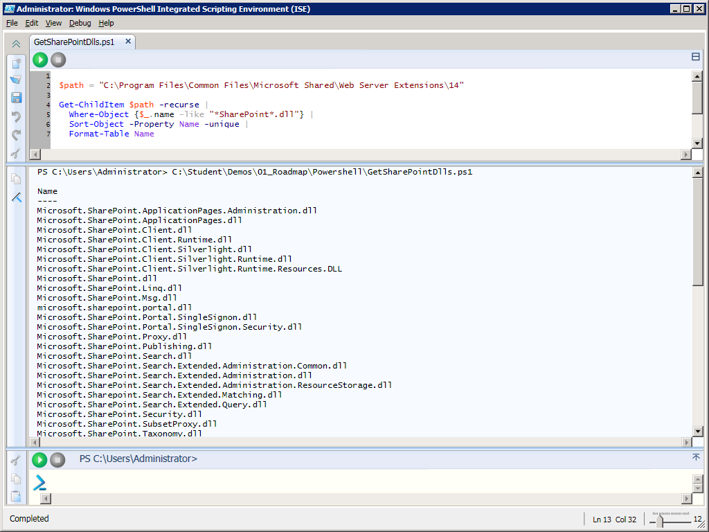
Editing Scripts using PowerShell ISE
Supports Color-coding, IntelliSense and debugging
Notes:
With the initial release of Powershell, administrators and developers usually resorted to writing scripts with NotePad. PowerShell 2 provides a nice development environment for writing PowerShell scripts named the PowerShell Integrated Scripting Environment (ISE).
When it comes t writing complex scripts with control of flow logic, it is really nice to be able to debug and single step through your code.

Slide 26
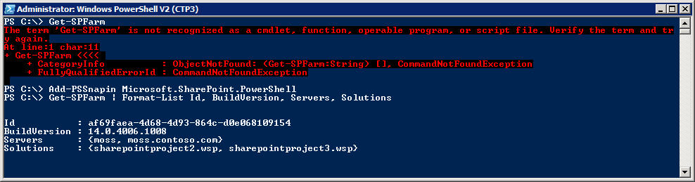
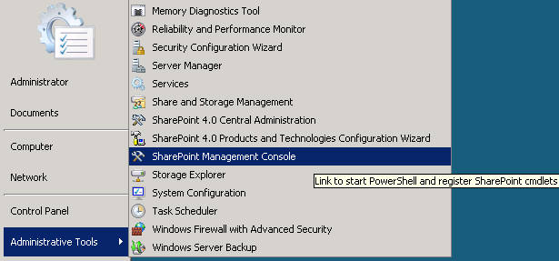
The SharePoint Powershell Snapin
Explicitly load SharePoint PowerShell snap-in from console or script
Implicitly load snap-in by using link in Windows Start menu
Begin using SharePoint Cmdlets
Notes:
SharePoint Server 2010 adds many Cmdlets for SharePoint administration through a Snap-in provider named Microsoft.SharePoint.PowerShell. The SharePoint cmdlets cannot be called until the SharePoint snap-in has been loaded.
There are two common ways to load the SharePoint snap-in
Call the Add-PSSnapin cmdlet and pass a parameter with the snap-in name
Launch the PowerShell console using SharePoint Management Console. This link points to an XML file that loads the SharePoint snap-in in a declarative fashion.

Slide 27
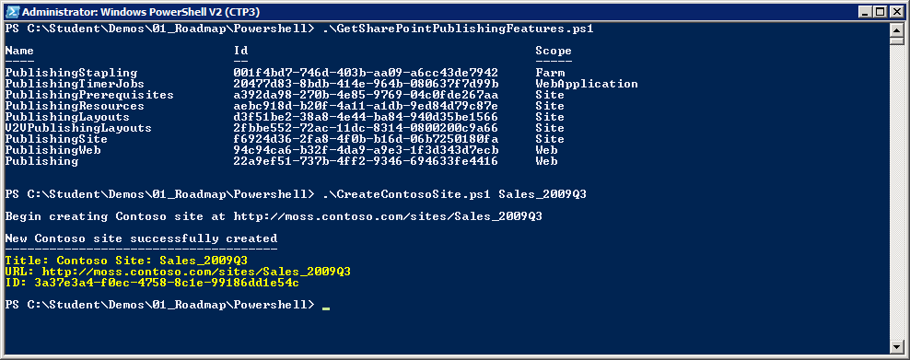
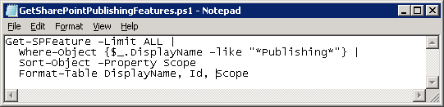
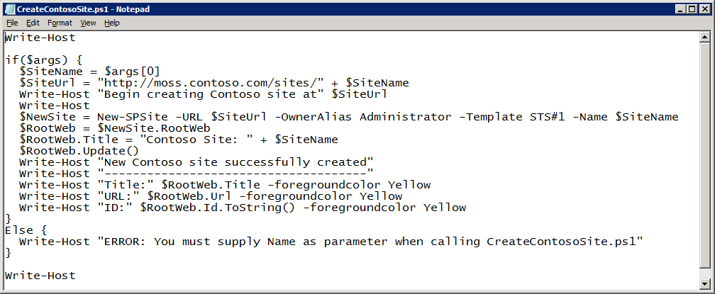
Examples of SharePoint Scripting
Notes:
The first example shows how to get a farm-wide list of all features that have been installed with a Display Name that contains the word "Publishing". This example also shows how to use PowerShell fundamentals for filtering, sorting and formatting.
The second example shows a PowerShell script which uses the New-SPSite cmdlet to create a new site. You should observe that the New-SPSite cmdlet returns a SPSite object which is then used to access the SPWeb object for the top-level site.

Slide 28
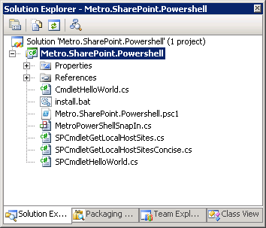
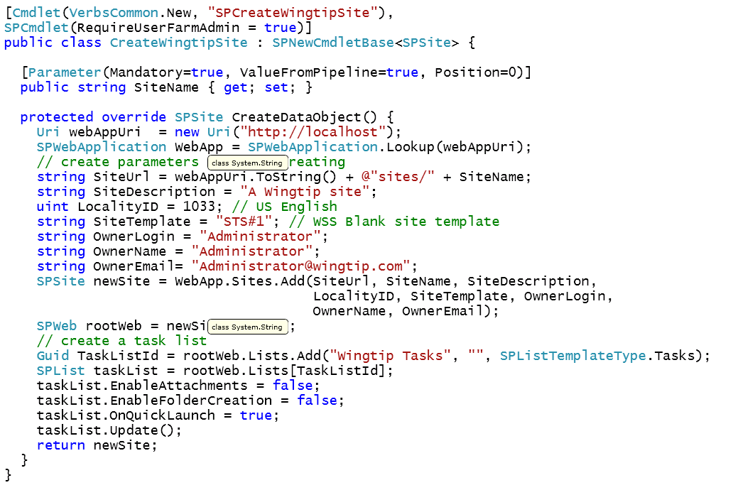
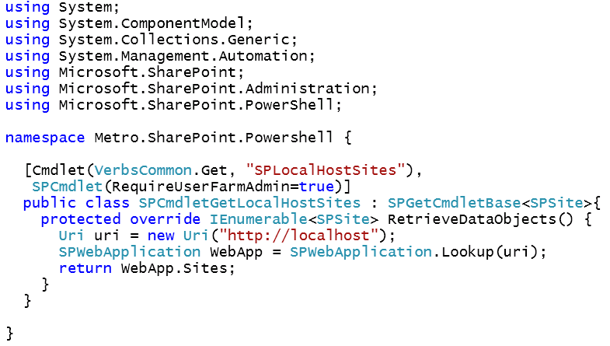
Creating a Custom Powershell Snap-in
PowerShell was created with extensibility in mind
SharePoint developers can create custom snap-ins
STSADM extensions now considered deprecated
Notes:
If you are going to work with SharePoint Server 2010 as a developer or as an administrator, you must learn PowerShell from the perspective of someone that consumes cmdlets. However, it some scenarios you might actually want to develop our own custom cmdlets by creating a PowerShell snap-in.
This approach allows you to develop in a richer environment like Visual Studio 2010 to build reusable components which encapsulate the logic for ongoing administrative tasks.

Slide 29
Developing a Custom PowerShell Snap-in
demo
Notes:
Demo Metro.SharePoint.PowerShell sample custom snap-in.

Slide 30
Summary
What’s New in SharePoint 2010
SharePoint 2010 Development Primer
New Developer Tools for SharePoint 2010
SharePoint 2010 Integration with PowerShell

